Slide 1
A spectacular lunar graze
2015 Nov 17
Dave Herald

Slide 2
Lunar grazes have multiple events as the star skims along the lunar limb
When grazes were commonly observed, it was not possible to accurately predict where a large number of events could be observed
This has changed with the advent of data from the Kaguya, and subsequently the LRO LOLA missions

Slide 3
Lunar graze profile
Occult can now generate lunar limb graze profiles having very detailed resolution
Enables the observer to position themselves to observe large number of events
Enhanced opportunities to measure stellar diameter, or double star properties

Slide 4
Profile changes with longitude
The graze profile varies along the path
To maximise the number of events, consider selecting the site longitude
The example shows the changes at steps of 0.5° (about 30 miles) along the path
GrazeProfile 635cG8 2016 Feb 16.gif

Slide 5
Graze on 2015 Nov 17
On 2015 Nov 17, a good graze occurred close to my home.
David & Joan Dunham had recently arrived in Canberra from Alice Springs – but had not yet unpacked….
On the night, over a distance of 272 meters:
Joan was set up in time, but could only record the first half because of increasing cirrus
David was unable to set up in time
I observed through thin but increasing cirrus

Slide 6
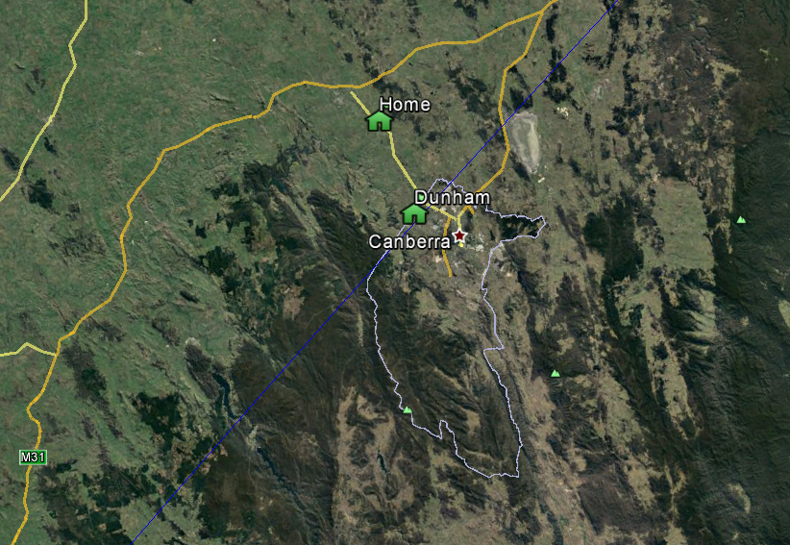
Predicted path

Slide 7
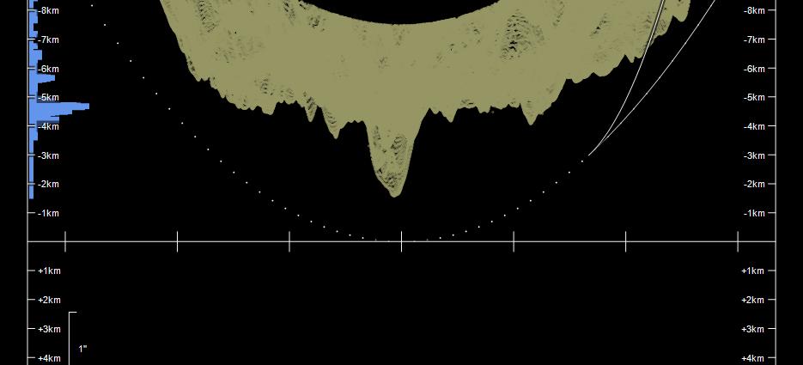
Graze profile, with Dunham’s home site indicated
Found an observing location to maximise the number of events – at about 4.7km in

Slide 8
Video of the event
The video of the graze is on YouTube. Address is
https://www.youtube.com/watch?v=ucAP5FAx9uA

Slide 9
Results
Telescopes:
Aperture Longitude Latitude Alt
# cm o ' " o ' " m
A 20 +149 0 9.1 -35 9 57.5 591
B 20 +149 0 7.1 -35 10 6.2 597
ref Tel Observer Star No. y m d h m s PhGrMrCeDb O-C
001 A D. Herald S 163293 2015 11 17 10 38 52.18 DD G G 2 0.03
002 A D. Herald S 163293 2015 11 17 10 38 52.30 RD G G 2 0.03
003 A D. Herald S 163293 2015 11 17 10 38 52.94 DD G G 1 0.01
004 A D. Herald S 163293 2015 11 17 10 38 59.94 RD G G 1 -0.01
005 A D. Herald S 163293 2015 11 17 10 39 0.14 DD G G 1 -0.01
006 A D. Herald S 163293 2015 11 17 10 39 3.40 RD G G 1 0.00
007 A D. Herald S 163293 2015 11 17 10 39 3.82 DD G G 1 0.00
008 A D. Herald S 163293 2015 11 17 10 39 4.26 RD G G 1 0.01
009 A D. Herald S 163293 2015 11 17 10 39 5.02 DD G G 1 0.01
010 A D. Herald S 163293 2015 11 17 10 39 13.44 RD G G 1 -0.02
011 A D. Herald S 163293 2015 11 17 10 39 29.62 DD G G 1 -0.01
012 A D. Herald S 163293 2015 11 17 10 39 29.66 RD G G 1 -0.01
013 A D. Herald S 163293 2015 11 17 10 39 29.92 DD G G 1 -0.02
014 A D. Herald S 163293 2015 11 17 10 39 35.60 RD G G 1 -0.04
015 A D. Herald S 163293 2015 11 17 10 39 37.30 DD G G 1 0.01
016 A D. Herald S 163293 2015 11 17 10 40 54.02 RD G G 1 0.01
017 A D. Herald S 163293 2015 11 17 10 40 55.98 DD G G 1 0.00
018 A D. Herald S 163293 2015 11 17 10 40 59.78 RD G G 1 0.01
019 A D. Herald S 163293 2015 11 17 10 41 0.02 DD G G 1 0.01
020 A D. Herald S 163293 2015 11 17 10 41 0.08 RD G G 1 0.02
021 A D. Herald S 163293 2015 11 17 10 41 0.30 DD G G 1 0.02
022 A D. Herald S 163293 2015 11 17 10 41 0.38 RD G G 1 0.02
023 A D. Herald S 163293 2015 11 17 10 41 0.42 DD G G 1 0.02
024 A D. Herald S 163293 2015 11 17 10 41 1.38 RD G G 1 0.02
025 A D. Herald S 163293 2015 11 17 10 41 1.62 DD G G 1 0.01
026 A D. Herald S 163293 2015 11 17 10 41 1.74 RD G G 1 0.01
027 A D. Herald S 163293 2015 11 17 10 41 2.14 DD G G 1 0.01
028 A D. Herald S 163293 2015 11 17 10 41 8.74 RD G G 1 0.04
029 A D. Herald S 163293 2015 11 17 10 41 8.94 DD G G 1 0.05
030 A D. Herald S 163293 2015 11 17 10 41 9.14 RD G G 1 0.05
031 A D. Herald S 163293 2015 11 17 10 41 9.26 DD G G 1 0.03
032 A D. Herald S 163293 2015 11 17 10 41 9.78 RD G G 1 0.02
033 A D. Herald S 163293 2015 11 17 10 41 9.90 DD G G 1 -0.07
034 A D. Herald S 163293 2015 11 17 10 41 10.10 RD G G 1 -0.07
035 A D. Herald S 163293 2015 11 17 10 41 10.18 DD G G 1 0.02
036 A D. Herald S 163293 2015 11 17 10 41 10.26 RD G G 1 0.01
037 A D. Herald S 163293 2015 11 17 10 41 10.74 DD G G 1 0.02
038 A D. Herald S 163293 2015 11 17 10 41 11.86 RD G G 1 0.01
039 A D. Herald S 163293 2015 11 17 10 41 11.98 BD G G 2 0.01
040 A D. Herald S 163293 2015 11 17 10 41 12.46 DD G G 2 -0.01
041 A D. Herald S 163293 2015 11 17 10 41 15.02 RD G G 2 0.00
042 A D. Herald S 163293 2015 11 17 10 41 15.70 DD G G 2 0.00
043 A D. Herald S 163293 2015 11 17 10 41 16.46 RD G G 1 0.00
044 A D. Herald S 163293 2015 11 17 10 41 22.30 DD G G 1 0.02
045 A D. Herald S 163293 2015 11 17 10 41 23.18 RD G G 1 0.01
046 A D. Herald S 163293 2015 11 17 10 41 24.10 DD G G 1 0.06
047 A D. Herald S 163293 2015 11 17 10 41 24.38 RD G G 1 0.10
048 A D. Herald S 163293 2015 11 17 10 41 25.86 DD G G 1 -0.02
049 A D. Herald S 163293 2015 11 17 10 41 39.78 RD G G 2 0.00
050 B J. Dunham S 163293 2015 11 17 10 39 7.09 DD G G 1 0.01
051 B J. Dunham S 163293 2015 11 17 10 39 12.00 RD G G 1 0.00
052 B J. Dunham S 163293 2015 11 17 10 39 30.75 DD G G 1 -0.02
053 B J. Dunham S 163293 2015 11 17 10 39 34.45 RD G G 2 0.00
B J. Dunham S 163293 2015 11 17 10 40 33.8 RD G G 1 0.00
Mean residual of events: 0.01" ±0.03"

Slide 10
Reduction plot
49 events detected at one site – a record
Plot also shows path for Joan Dunham – located just 272 metres south

Slide 11
Enlarged profile plots

